Slide 1
IT341 ML Lab
Logistic Regression

Slide 2
Logistic Regression
Model predicts the probability value for a binary outcome or state
Works with both continuous and discrete datasets
log of odds (logit) for an outcome is assumed to be linearly related with the input variables in the dataset
Using this relation, logistic function is derived to compute probability of an outcome for a given input sample.
It forms a curve like the "S" form. The S-form curve is called the Sigmoid function
Output of the logistic function is compared with a threshold value to get a binary outcome

Slide 3
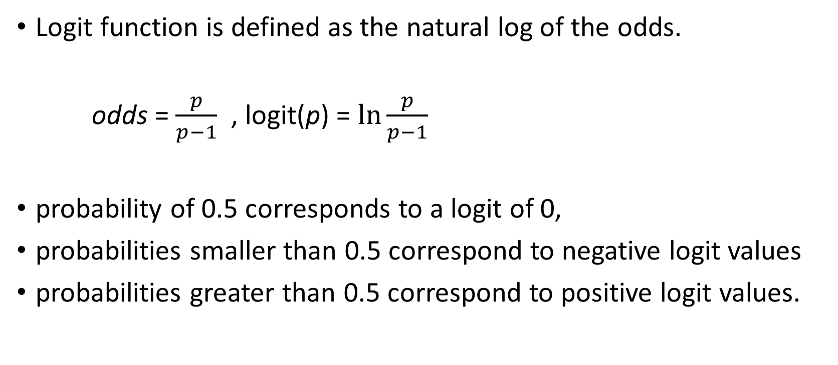
Logit Function
Logit function is defined as the natural log of the odds.
odds = $\frac{p}{p−1}$ , logit(p) = $\ln{\frac{p}{p−1}}$
probability of 0.5 corresponds to a logit of 0,
probabilities smaller than 0.5 correspond to negative logitvalues
probabilities greater than 0.5 correspond to positive logit values.

Slide 4



Deriving Logistic function

Slide 5
Logistic Regression
Through training the model coefficients (slope and bias) are adjusted to maximize the likelihood of correct prediction and hence minimize prediction error
The objective is to bring the predicted probability close to 1 for the data point corresponding to an outcome and close to 0 for the other outcome
After initial function is estimated, the process is repeated until Log Likelihood does not change significantly

Slide 6
Data Standardization
Standardizing a dataset involves rescaling the distribution of values so that the mean of observed values is 0 and the standard deviation is 1.
This can be thought of as subtracting the mean value or centering the data.
Standardize the input training and testing data
from sklearn.preprocessing import StandardScaler
scaler.fit_transform()

Slide 7
Sklearn Logistic Regression Model
from sklearn.linear_model import LogisticRegression
Common Parameters
solver- optimization algorithm
Regularization strength(C)
multi_class

Slide 8
Assignment 9
Problem 1
Implement binary classification using logistic regression
Print confusion matrix and accuracy
Check for overfitting
Problem 2
Implement multiclass classification (one versus rest strategy) using logistic regression
Print confusion matrix and accuracy
Check for overfitting

